Slide 1
4CCS1ISE – Introduction to Software Engineering
Week 4 – In-Person Interactive Learning Session
Dr Leonardo Magela Cunha
January,2023

Slide 2
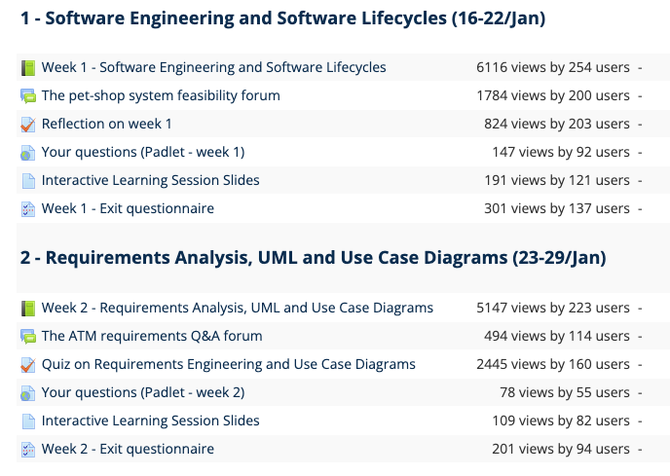
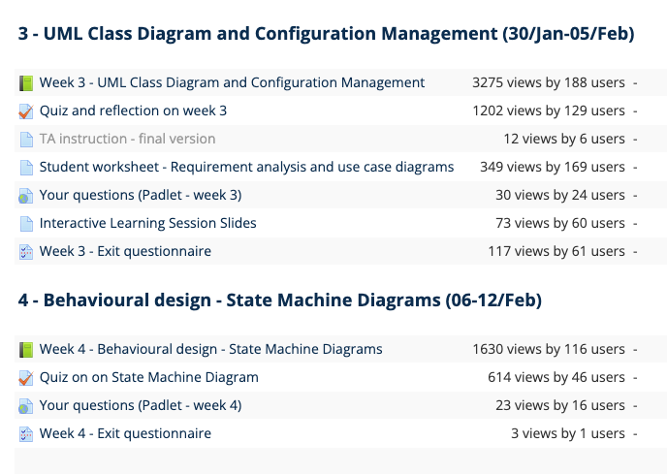
KEATS today at 14:00

Slide 3
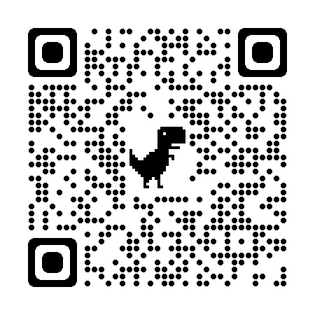
Week 3: Learning objectives
Be able to:
Create UML state machine diagrams;
Evaluate diagrams and understand some best practices in designing software models;
Review and consolidate your knowledge about system modelling.
Table of contents
Exit questionnaire 3 feedback
Q&A
State machine exercises
Week 4 SGTs KEATS feedback

Slide 4
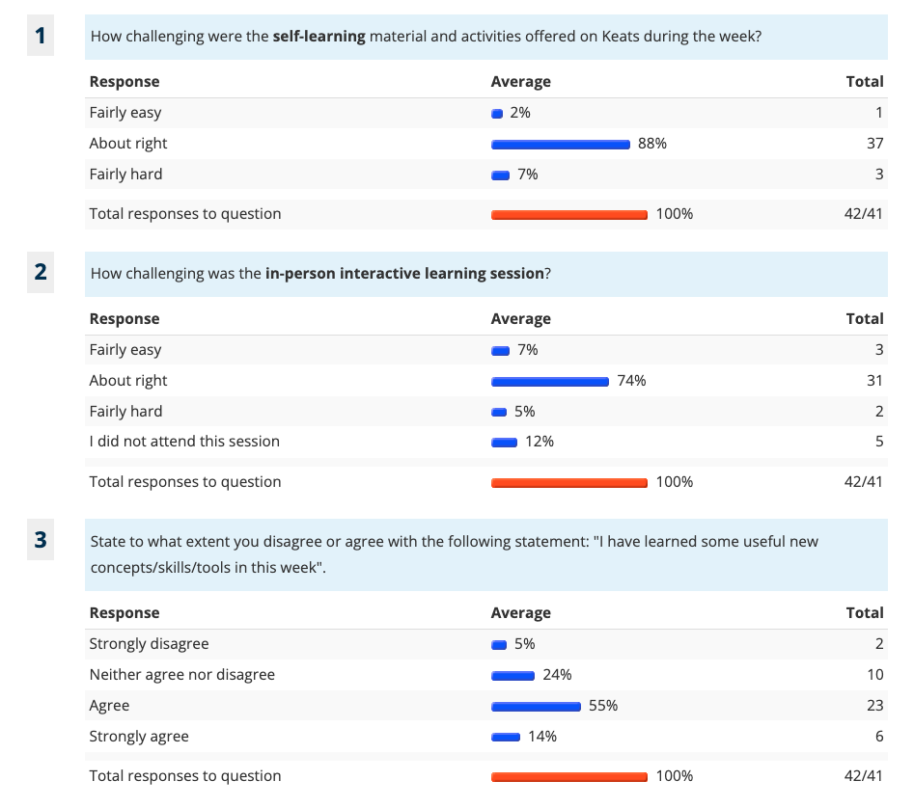
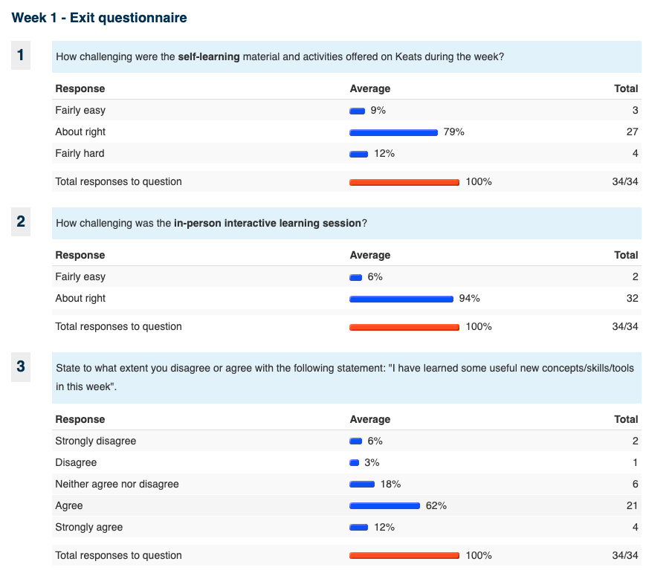
Exit Questionnaire – Week 2 and 3
2

Slide 5
Exit Questionnaire – Selected Comments and Feedback
Content
No comments
ILS
“Interactive in-person sessions are a little bit too slow on pacing”
“I do not feel that the ILS' are worthwhile or teach anything new. I feel like they are just a re-hashed version of the videos, but with even less content”
“I felt like the solutions provided in the LGT were a little too vague, I would love to work through a more detailed example (SIC), exam-style.”
The LGTs/ILS are designed to be as inclusive as possible. However, we empathize with students that need a faster pace, and we’ll do our best to improve this aspect of the ILS/LGTs.
We also understand the concerns with the exam questions, and the quizzes provided on KEATS all contain examples of such questions. Additionally, a mock exam will be provided. The ILS exercises are designed for you to have new perspectives on the subjects and open new discussions.

Slide 6
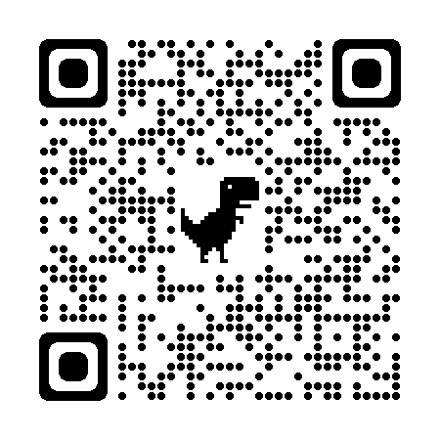
Q&A
https://kings.padlet.org/leonardomagela/2223iseweek04

Slide 7
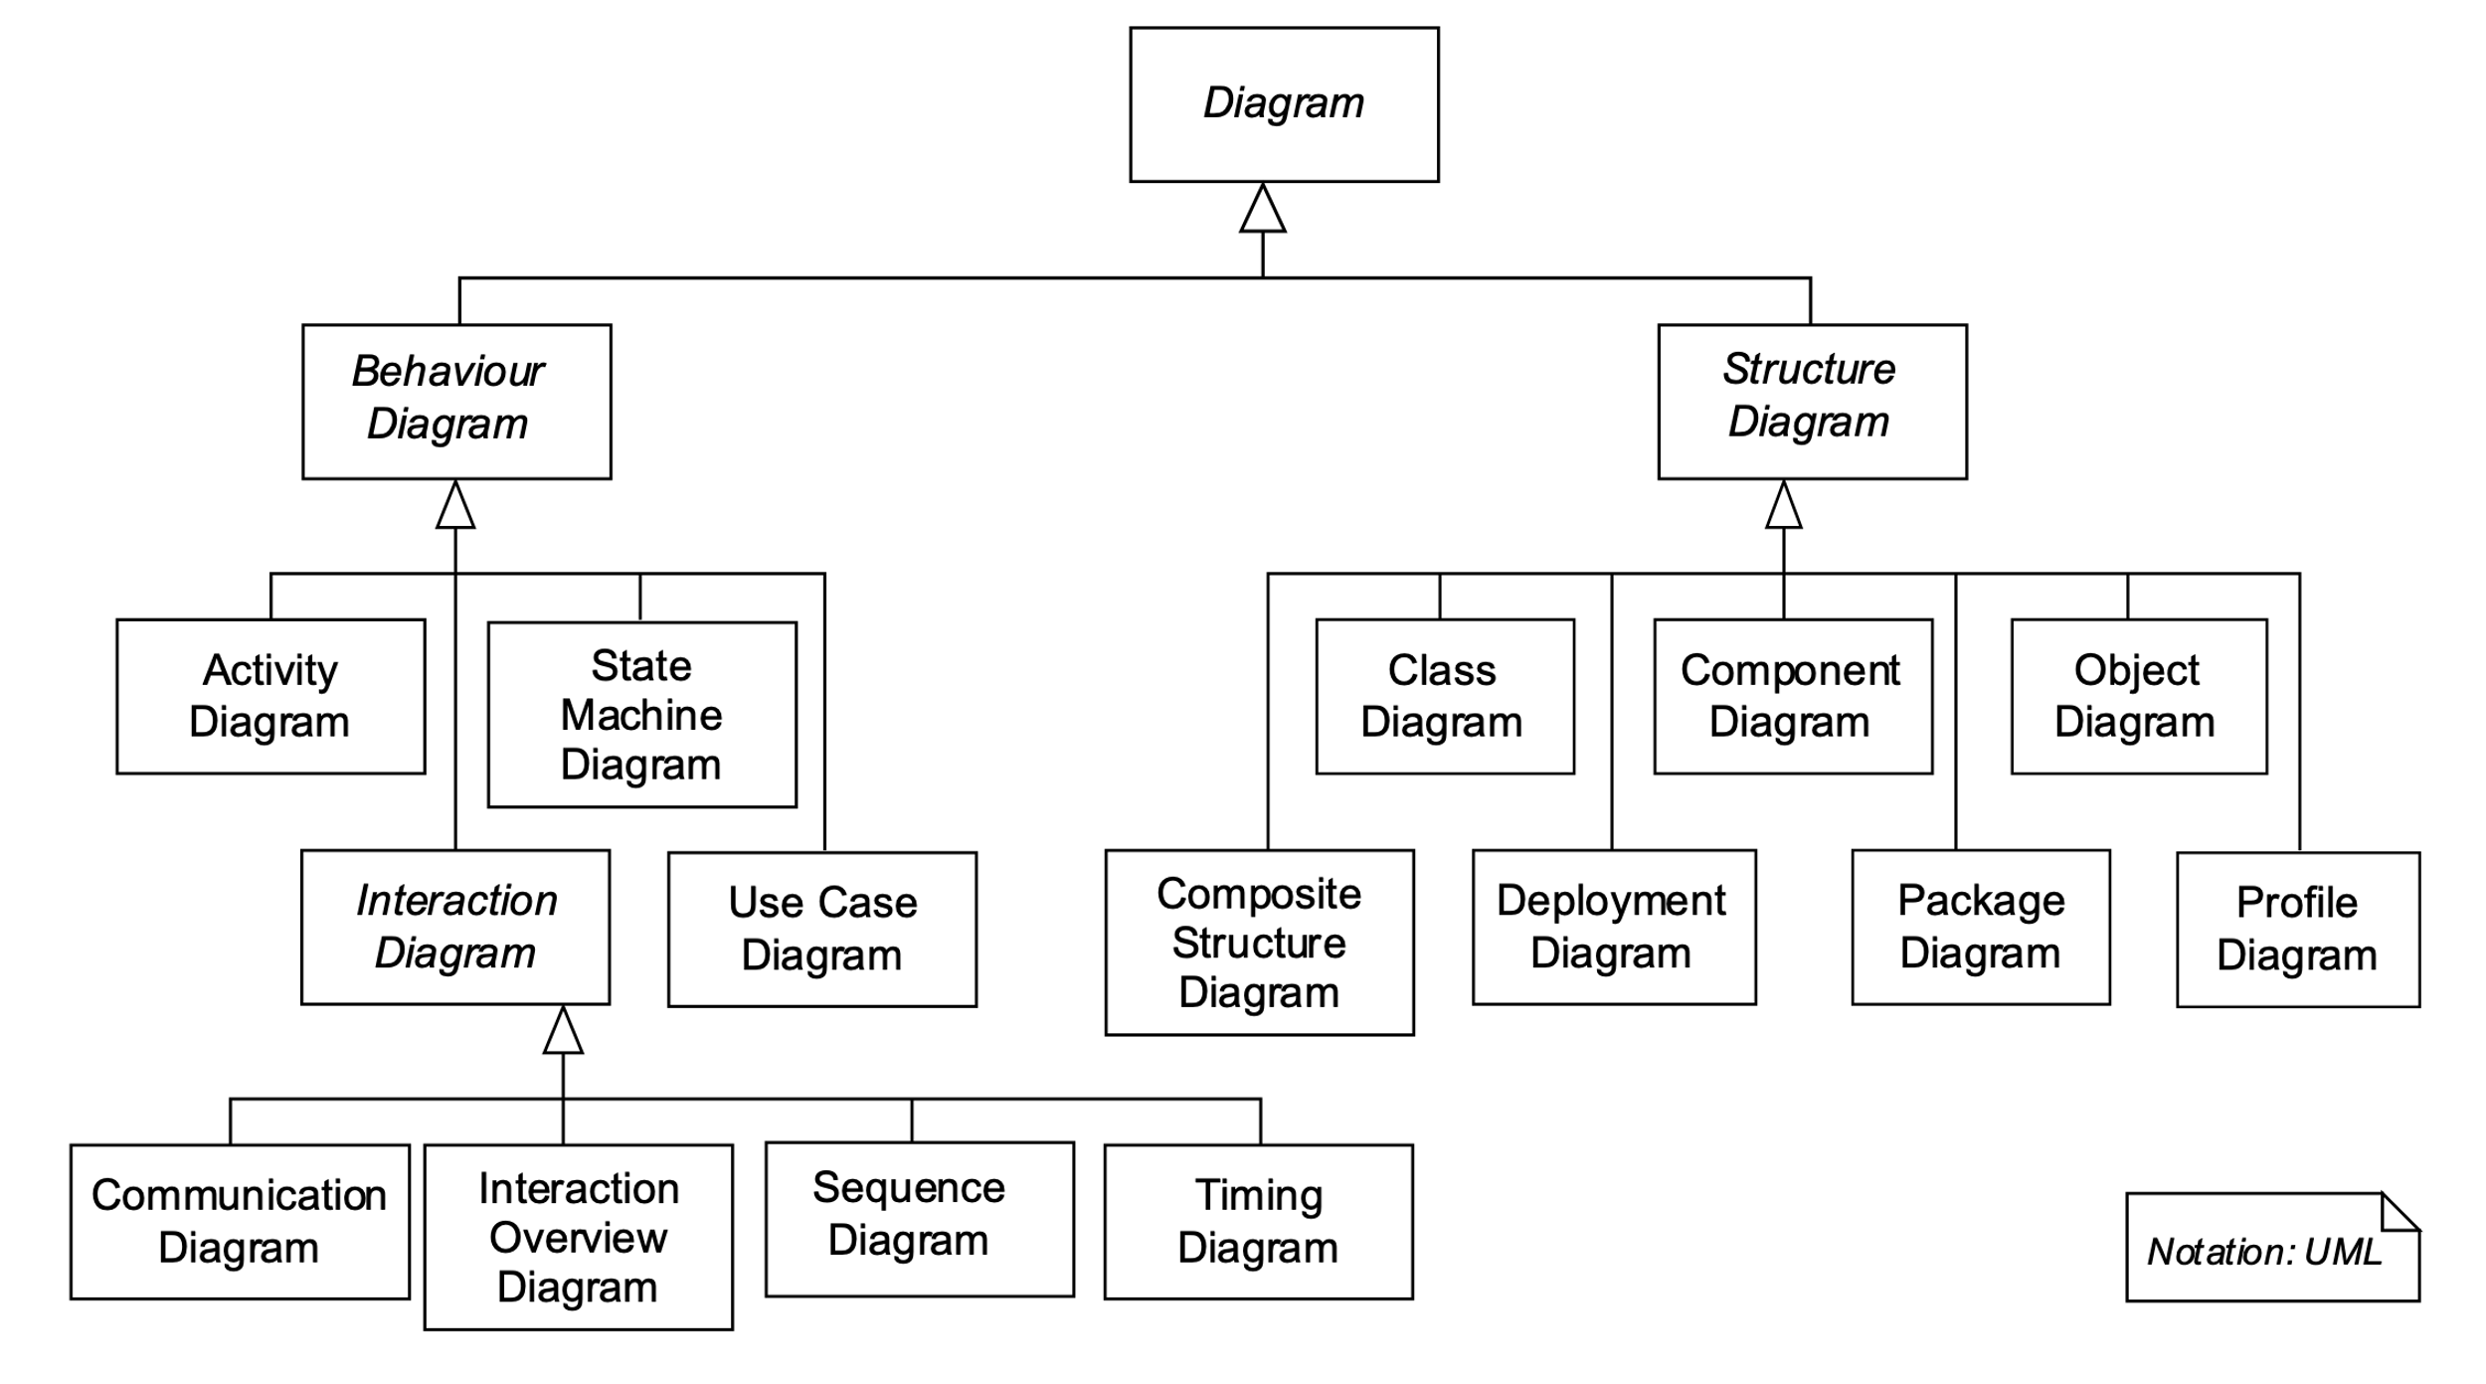
What can you model with UML?
UML 2.0 defines fourteen types of diagrams, divided into three categories: Seven diagram types represent static application structure; three represent general types of behaviour; and four represent different aspects of interactions:
Structure Diagrams
include the Class Diagram, Object Diagram, Component Diagram, Composite Structure Diagram, Package Diagram, Deployment Diagram and Profile Diagram.
Behaviour Diagrams
include the Use Case Diagram (used by some methodologies during requirements gathering); Activity Diagram, and State Machine Diagram.
Interaction Diagrams
all derived from the more general Behaviour Diagram, include the Sequence Diagram, Communication Diagram, Timing Diagram, and Interaction Overview Diagram.

Slide 8
Week 4 Feedback - Small Group Tutorials
From 06/02/23 09:00 AM (Monday)
To 12/02/23 11:55 PM (Sunday)
https://keats.kcl.ac.uk/mod/lti/view.php?id=6334045

Slide 9

Data type Stack
Model the stack data structure
Elements can be placed on the stack using the push function and removed from the stack using the pop function. The order in which elements are removed follows the LIFO principle (Last In, First Out), which means that pop always delivers the element that was last placed on the stack with push and removes it from the stack. A further function that the class Stack should support is the determination of the actual size of the stack, that is, the number of elements on the stack.
Source: UML@Classroom

Slide 10
Use cases diagram

Slide 11
Class Diagram

Slide 12
State machine diagram

Slide 13
Extend/reuse the stack (Homework/extra exercise)
Add the ability to query about whether an element is on the stack at all.

Slide 14
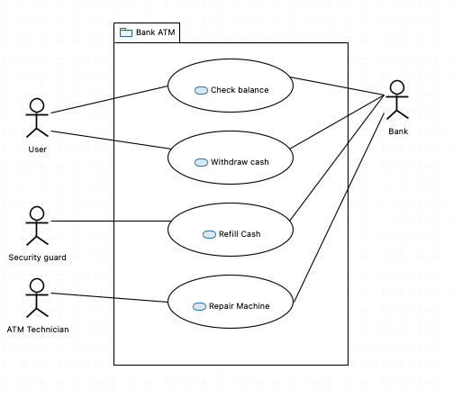
ATM use cases
Create a class diagram based on this ATM use cases diagram

Slide 15
ATM State Machine
Additional requirements:
When the ATM is turned on, it should perform a self test to check if it is working properly.
In case the case the ATM is in maintenance(or refilling) or out of service(due to an error), it should not allow the customer to perform any transactions.

Slide 16
ATM State Machine

Slide 17



Person Marital Status
The Marriage and Civil Partnership (Minimum Age) Act 2022 received Royal Assent in April 2022. It is planned to come into effect on Monday 27 February 2023.
For full details of the provisions of this Act, see Marriage And Civil Partnership (Minimum Age) Act 2022 (legislation.gov.uk).
Draw a state machine diagram to represent the marital status of a person.

Slide 18
Person Marital Status

Slide 19
Contact details/for more information Leonardo Magela Cunha
leonardo.magela@kcl.ac.uk
© 2020 King’s College London. All rights reserved

